Slide 1

Network Flow
Prepared by Shmuel Wimer
Courtesy of Prof. Dror Rawitz

Slide 2
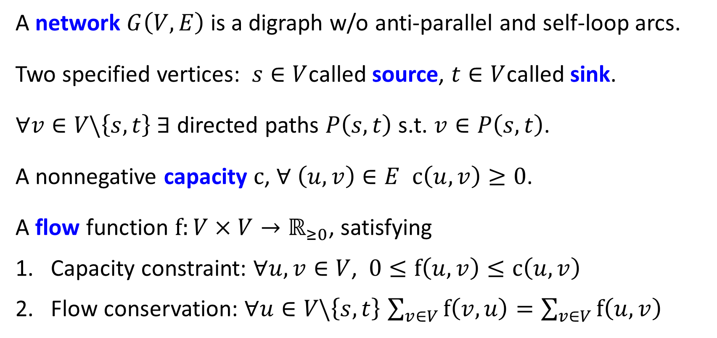
Definitions
A network $G\left(V, E\right)$ is a digraph w/o anti-parallel and self-loop arcs.
Two specified vertices: $s∈V$called source, $t∈V$called sink.
$∀v∈V\backslash \left\{s,t\right\}$ $∃$ directed paths $P\left(s,t\right)$ s.t. $v∈P\left(s,t\right)$.
A nonnegative capacity $\text{c}$, $∀ \left(u,v\right)∈E$ $\text{c}\left(u,v\right)≥0$.
A flow function $\text{f}:V×V→ℝ_{≥0}$, satisfying
Capacity constraint: $∀u,v∈V$, $\text{0}≤\text{f}\left(u,v\right)≤\text{c}\left(u,v\right)$
Flow conservation: $∀u∈V\backslash \left\{s,t\right\}$ $\sum_{v∈V}{\text{f}\left(v,u\right)}=\sum_{v∈V}{\text{f}\left(u,v\right)}$

Slide 3
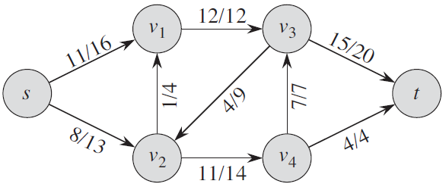
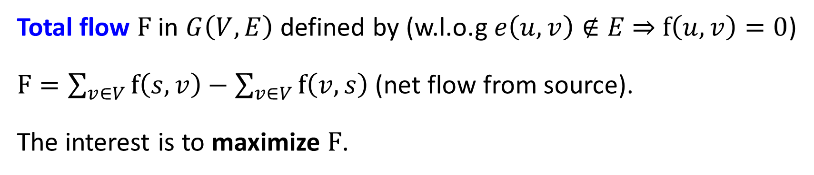

Total flow $F$ in $G\left(V, E\right)$ defined by (w.l.o.g $e\left(u,v\right)∉E$ ⇒ $\text{f}\left(u,v\right)=0$)
$F=\sum_{v∈V}{\text{f}\left(s,v\right)}−\sum_{v∈V}{\text{f}\left(v,s\right)}$ (net flow from source).
The interest is to maximize $F$.
flow
capacity
$\text{Total} \text{flow} 19$

Slide 4
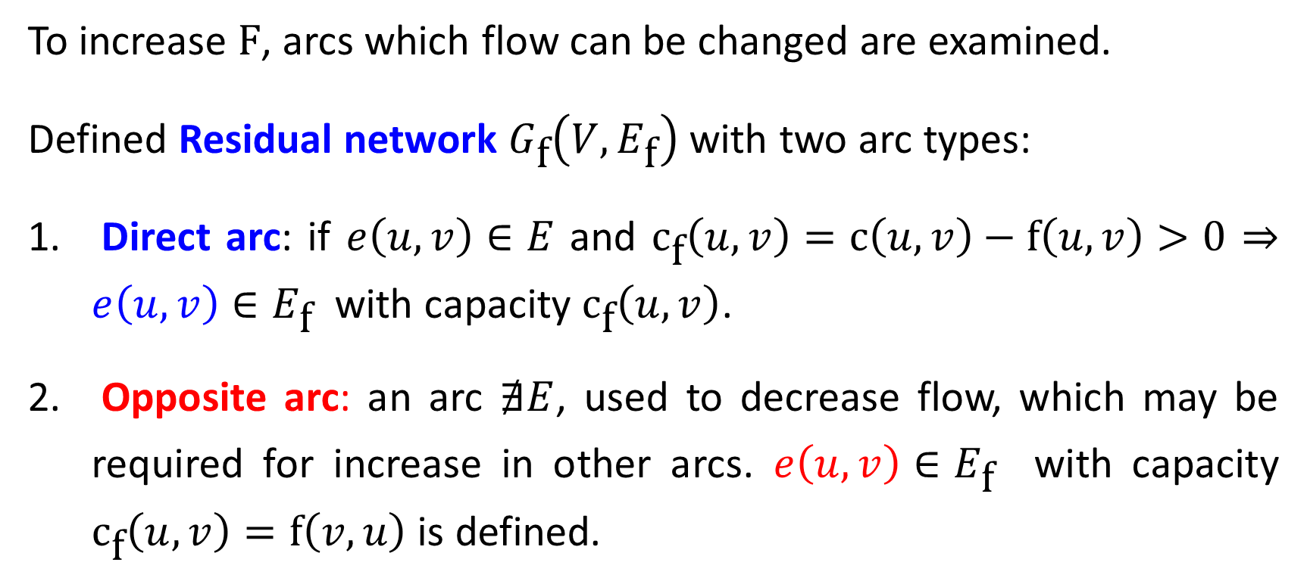
Residual networks
To increase $\text{F}$, arcs which flow can be changed are examined.
Defined Residual network $G_{\text{f}}\left(V,E_{\text{f}}\right)$ with two arc types:
Direct arc: if $e\left(u,v\right)∈E$ and ${\text{c}}_{\text{f}}\left(u,v\right)=\text{c}\left(u,v\right)−\text{f}\left(u,v\right)>0$ ⇒ $e\left(u,v\right)∈E_{\text{f}}$ with capacity ${\text{c}}_{\text{f}}\left(u,v\right)$.
Opposite arc: an arc $∄E$, used to decrease flow, which may be required for increase in other arcs. $e\left(u,v\right)∈E_{\text{f}}$ with capacity ${\text{c}}_{\text{f}}\left(u,v\right)=\text{f}\left(v,u\right)$ is defined.

Slide 5
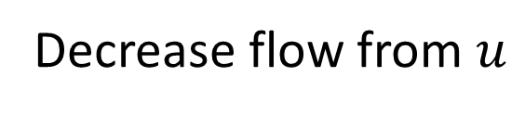
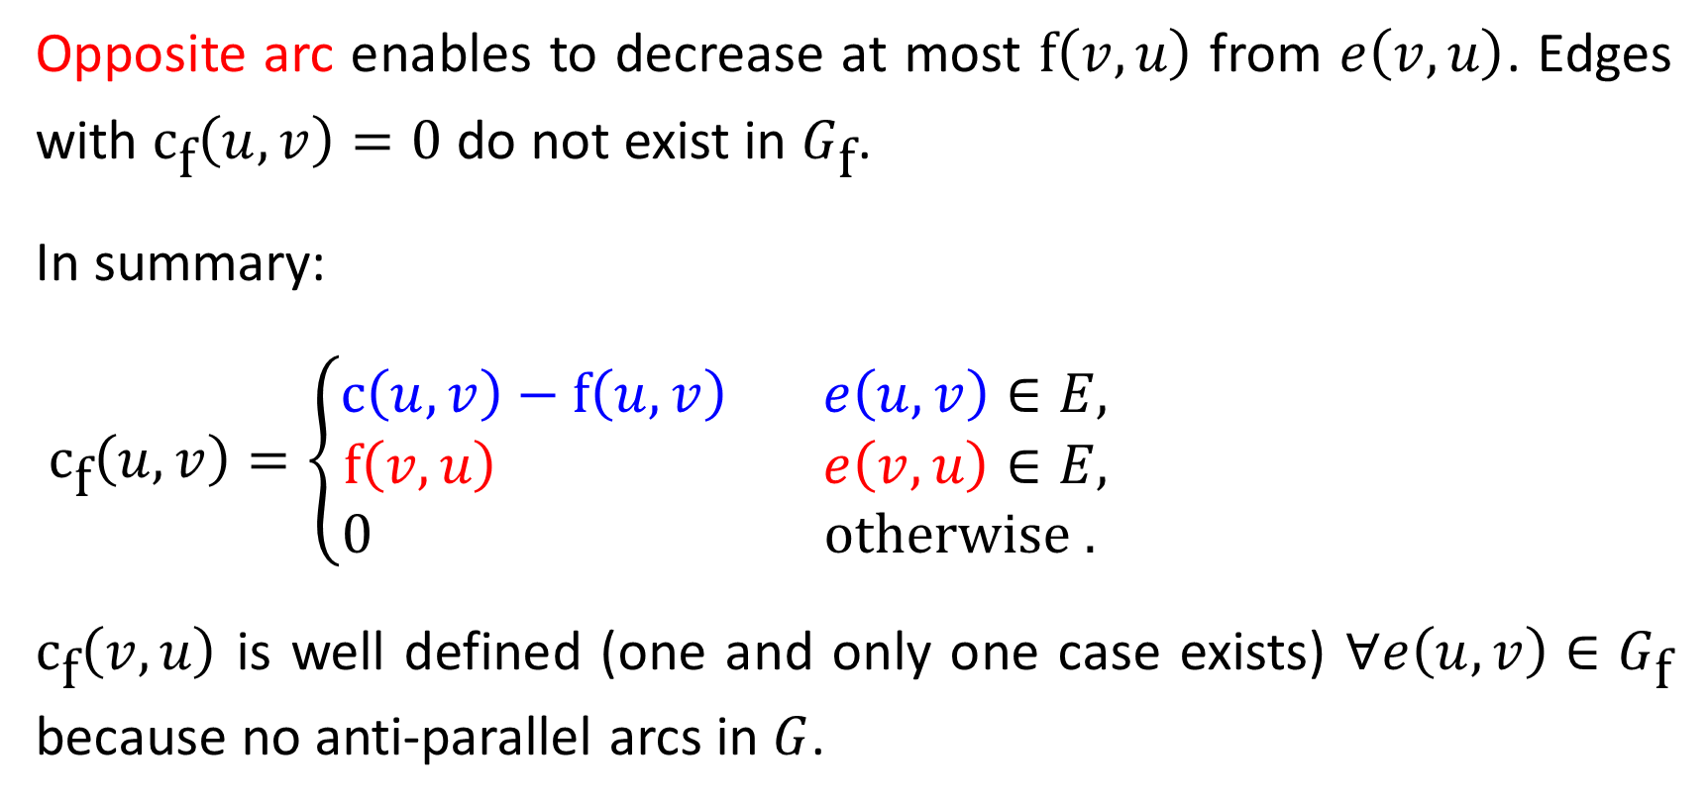
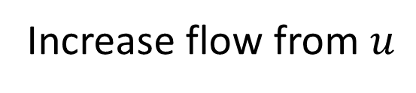
Opposite arc enables to decrease at most $\text{f}\left(v,u\right)$ from $e\left(v,u\right)$. Edges with ${\text{c}}_{\text{f}}\left(u,v\right)=0$ do not exist in $G_{\text{f}}$.
In summary:
${\text{c}}_{\text{f}}\left(u,v\right)=\left\{\begin{matrix}\text{c}\left(u,v\right)−\text{f}\left(u,v\right) & e\left(u,v\right)∈E, \\ \text{f}\left(v,u\right) & e\left(v,u\right)∈E, \\ 0 & \text{otherwise} . \end{matrix}\right.$
${\text{c}}_{\text{f}}\left(v,u\right)$ is well defined (one and only one case exists) $∀e\left(u,v\right)∈G_{\text{f}}$ because no anti-parallel arcs in $G$.
Increase flow from $u$
Decrease flow from $u$

Slide 6























$$G\left(V,E\right)$$
$$v_{1}$$
$$12$$
$$v_{3}$$
$$5$$
$$5$$
$$G_{\text{f}}\left(V,E_{\text{f}}\right)$$
$$s$$
$$11$$
$$4$$
$$15$$
$$t$$
$$1$$
$$3$$
$$7$$
$$5$$
$$5$$
$$8$$
$$3$$
$$v_{4}$$
$$4$$
$$v_{2}$$
$$11$$

Slide 7

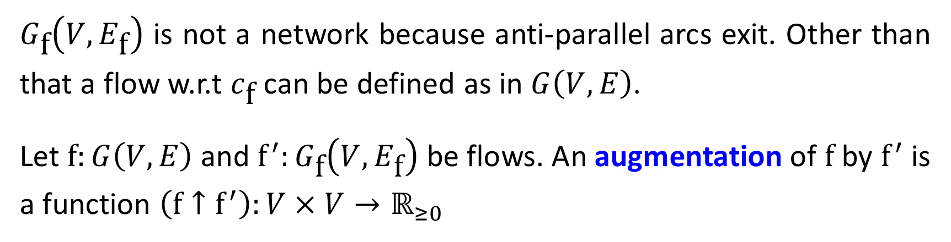
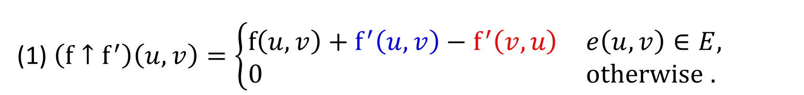

$G_{\text{f}}\left(V,E_{\text{f}}\right)$ is not a network because anti-parallel arcs exit. Other than that a flow w.r.t $c_{\text{f}}$ can be defined as in $G\left(V,E\right)$.
Let $\text{f}:G\left(V,E\right)$ and ${\text{f}}^{′}:G_{\text{f}}\left(V,E_{\text{f}}\right)$ be flows. An augmentation of $\text{f}$ by ${\text{f}}^{′}$ is a function $\left(\text{f}↑{\text{f}}^{′}\right):V×V→ℝ_{≥0}$
(1) $\left(\text{f}↑{\text{f}}^{′}\right)\left(u,v\right)=\left\{\begin{matrix}\text{f}\left(u,v\right)+{\text{f}}^{′}\left(u,v\right)−{\text{f}}^{′}\left(v,u\right) & e\left(u,v\right)∈E, \\ 0 & \text{otherwise} . \end{matrix}\right.$
Increase flow in $G$
Decrease flow in $G$

Slide 8
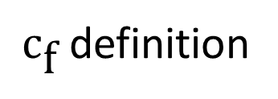
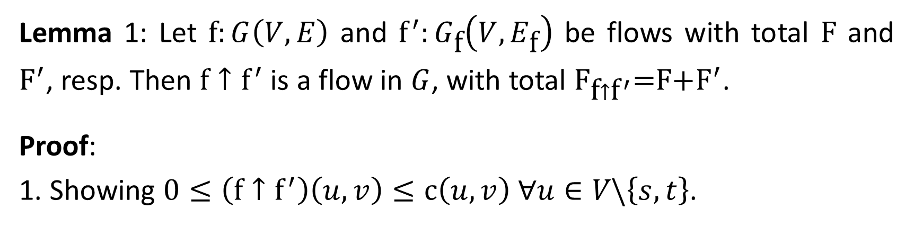
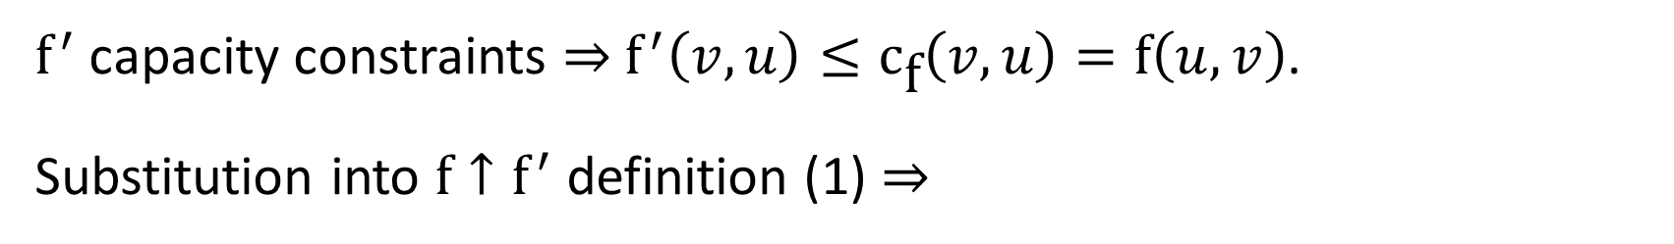

Lemma 1: Let $\text{f}:G\left(V,E\right)$ and ${\text{f}}^{′}:G_{\text{f}}\left(V,E_{\text{f}}\right)$ be flows with total $\text{F}$ and ${\text{F}}^{′}$, resp. Then $\text{f}↑{\text{f}}^{′}$ is a flow in $G$, with total $F_{\text{f}↑{\text{f}}^{′}}\text{=}\text{F}\text{+}{\text{F}}^{′}$.
Proof:
1. Showing $0≤\left(\text{f}↑{\text{f}}^{′}\right)\left(u,v\right)≤\text{c}\left(u,v\right)$ ∀$u∈V\backslash \left\{s,t\right\}$.
${\text{f}}^{′}$ capacity constraints ⇒ ${\text{f}}^{′}\left(v,u\right)≤{\text{c}}_{\text{f}}\left(v,u\right)=\text{f}\left(u,v\right)$.
Substitution into $\text{f}↑{\text{f}}^{′}$ definition (1) ⇒
${\text{c}}_{\text{f}}$ definition
$${\text{f}}^{′}\left(v,u\right)≤{\text{c}}_{\text{f}}\left(v,u\right)=f\left(u,v\right)$$
$\left(\text{f}↑{\text{f}}^{′}\right)\left(u,v\right)≥\text{f}\left(u,v\right)+{\text{f}}^{′}\left(u,v\right)−\text{f}\left(u,v\right)={\text{f}}^{′}\left(u,v\right)≥0$.

Slide 9
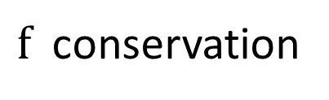
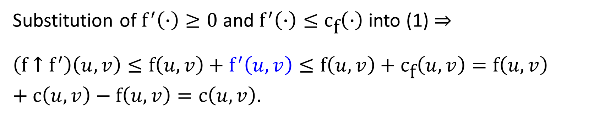
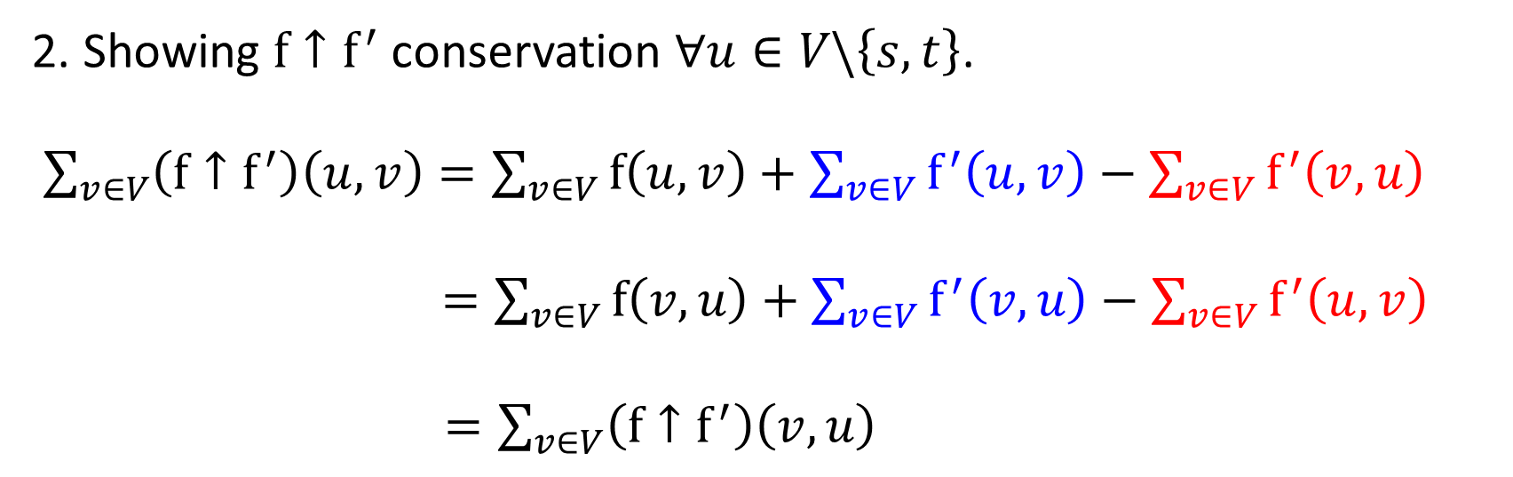
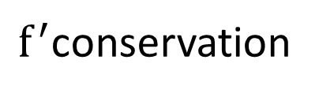
Substitution of ${\text{f}}^{′}\left(∙\right)≥0$ and ${\text{f}}^{′}\left(∙\right)≤{\text{c}}_{\text{f}}\left(∙\right)$ into (1) ⇒
$\left(\text{f}↑{\text{f}}^{′}\right)\left(u,v\right)≤\text{f}\left(u,v\right)+{\text{f}}^{′}\left(u,v\right)≤\text{f}\left(u,v\right)+{\text{c}}_{\text{f}}\left(u,v\right)=\text{f}\left(u,v\right)+\text{c}\left(u,v\right)−\text{f}\left(u,v\right)=\text{c}\left(u,v\right)$.
2. Showing $\text{f}↑{\text{f}}^{′}$ conservation ∀$u∈V\backslash \left\{s,t\right\}$.
$\sum_{v∈V}{\left(\text{f}↑{\text{f}}^{′}\right)\left(u,v\right)}=\sum_{v∈V}{\text{f}\left(u,v\right)}+\sum_{v∈V}{{\text{f}}^{′}\left(u,v\right)}−\sum_{v∈V}{{\text{f}}^{′}\left(v,u\right)}$
$=\sum_{v∈V}{\text{f}\left(v,u\right)}+\sum_{v∈V}{{\text{f}}^{′}\left(v,u\right)}−\sum_{v∈V}{{\text{f}}^{′}\left(u,v\right)}$
$=\sum_{v∈V}{\left(\text{f}↑{\text{f}}^{′}\right)\left(v,u\right)}$
definition (1)
$\text{f}$ conservation
${\text{f}}^{′}$conservation

Slide 10
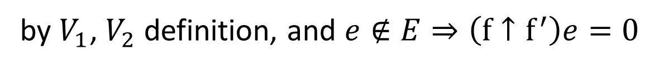
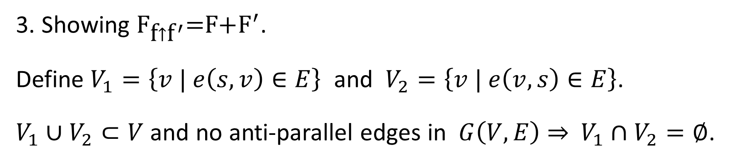
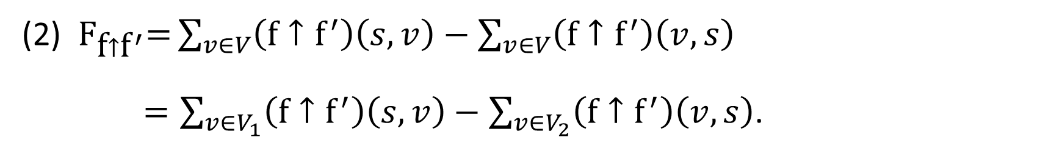
3. Showing $F_{\text{f}↑{\text{f}}^{′}}\text{=}\text{F}\text{+}{\text{F}}^{′}$.
Define $V_{1}=\left\{v | e\left(s,v\right)∈E\right\}$ and $V_{2}=\left\{v | e\left(v,s\right)∈E\right\}$.
$V_{1}∪V_{2}⊂V$ and no anti-parallel edges in $G\left(V,E\right)$ ⇒ $V_{1}∩V_{2}=∅$.
flow definition
(2) $F_{\text{f}↑{\text{f}}^{′}}\text{=}\sum_{v∈V}{\left(\text{f}↑{\text{f}}^{′}\right)\left(s,v\right)}−\sum_{v∈V}{\left(\text{f}↑{\text{f}}^{′}\right)\left(v,s\right)}$
$=\sum_{v∈V_{1}}{\left(\text{f}↑{\text{f}}^{′}\right)\left(s,v\right)}−\sum_{v∈V_{2}}{\left(\text{f}↑{\text{f}}^{′}\right)\left(v,s\right)}$.
by $V_{1}$, $V_{2}$ definition, and $e∉E⇒\left(\text{f}↑{\text{f}}^{′}\right)e=0$

Slide 11

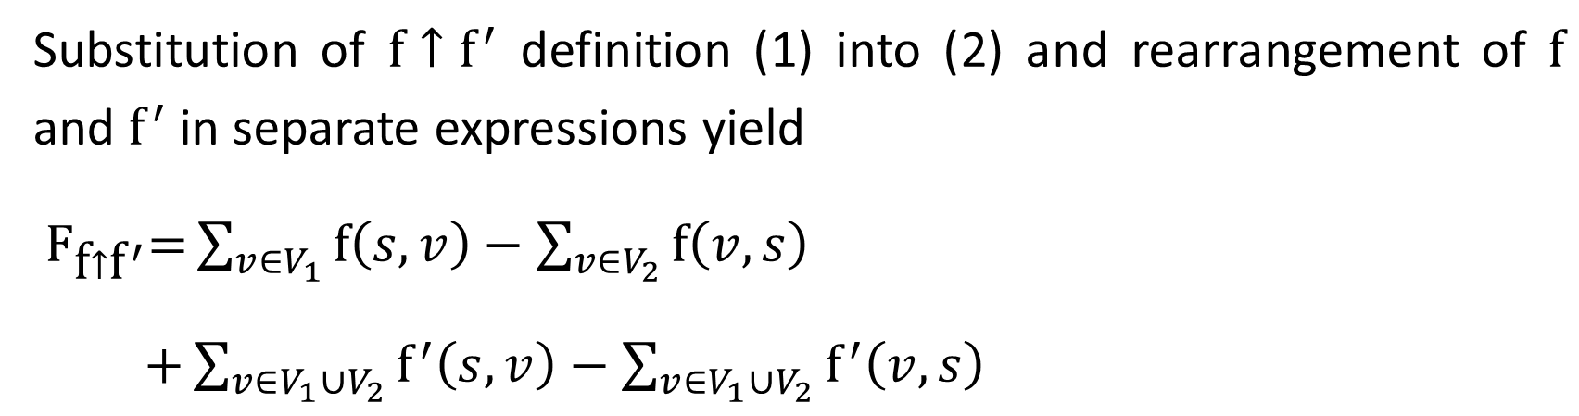
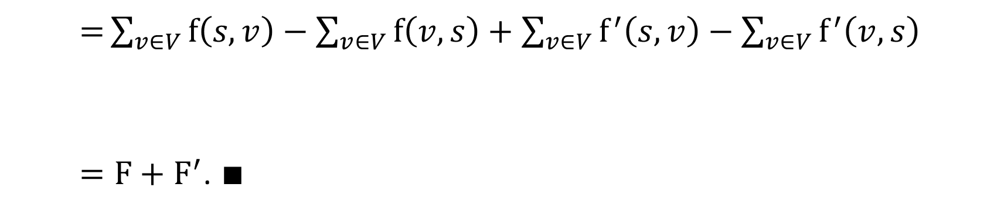
Substitution of $\text{f}↑{\text{f}}^{′}$ definition (1) into (2) and rearrangement of $\text{f}$ and ${\text{f}}^{′}$ in separate expressions yield
$F_{\text{f}↑{\text{f}}^{′}}\text{=}\sum_{v∈V_{1}}{\text{f}\left(s,v\right)}−\sum_{v∈V_{2}}{\text{f}\left(v,s\right)}$
$+\sum_{v∈V_{1}∪V_{2}}{{\text{f}}^{′}\left(s,v\right)}−\sum_{v∈V_{1}∪V_{2}}{{\text{f}}^{′}\left(v,s\right)}$
$\text{=}\sum_{v∈V}{\text{f}\left(s,v\right)}−\sum_{v∈V}{\text{f}\left(v,s\right)}+\sum_{v∈V}{{\text{f}}^{′}\left(s,v\right)}−\sum_{v∈V}{{\text{f}}^{′}\left(v,s\right)}$
$=F+{\text{F}}^{′}$. $∎$
$$e∉E⇒\left(\text{f}↑{\text{f}}^{′}\right)e=0$$

Slide 12












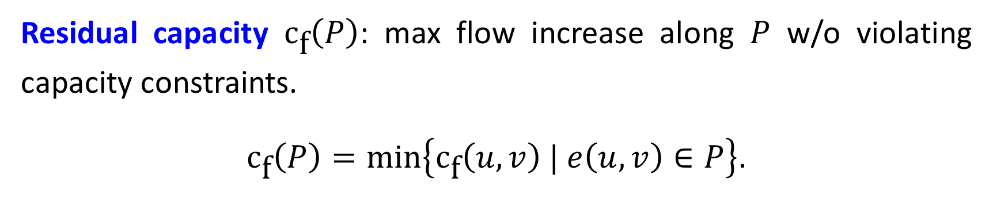









Augmentation paths
An augmentation path $P$ in $G_{\text{f}}\left(V,E_{\text{f}}\right)$ is a simple path from $s$ to $t$.
$$v_{1}$$
$$12$$
$$v_{3}$$
$$5$$
$$5$$
$$s$$
$$11$$
$$4$$
$$15$$
$$t$$
$$1$$
$$3$$
$$7$$
$$5$$
$$5$$
$$8$$
$$3$$
$$v_{4}$$
$$4$$
$$v_{2}$$
$$11$$
Residual capacity ${\text{c}}_{\text{f}}\left(P\right)$: max flow increase along $P$ w/o violating capacity constraints.
${\text{c}}_{\text{f}}\left(P\right)=\min\left\{{\text{c}}_{\text{f}}\left(u,v\right) | e\left(u,v\right)∈P\right\}$.

Slide 13
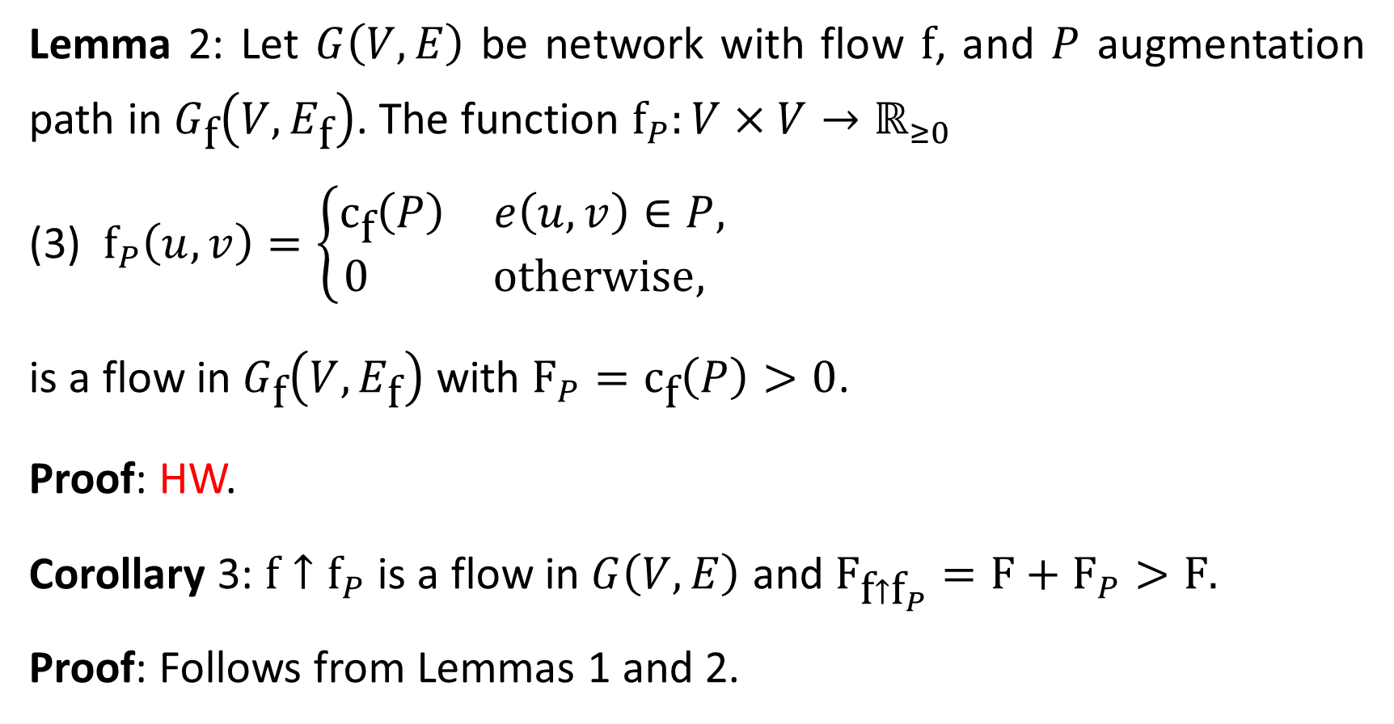
Lemma 2: Let $G\left(V,E\right)$ be network with flow $\text{f}$, and $P$ augmentation path in $G_{\text{f}}\left(V,E_{\text{f}}\right)$. The function ${\text{f}}_{P}:V×V→ℝ_{≥0}$
(3) ${\text{f}}_{P}\left(u,v\right)=\left\{\begin{matrix}{\text{c}}_{\text{f}}\left(P\right) & e\left(u,v\right)∈P, \\ 0 & \text{otherwise}, \end{matrix}\right.$
is a flow in $G_{\text{f}}\left(V,E_{\text{f}}\right)$ with ${\text{F}}_{P}={\text{c}}_{\text{f}}\left(P\right)>0$.
Proof: HW.
Corollary 3: $\text{f}↑{\text{f}}_{P}$ is a flow in $G\left(V,E\right)$ and ${\text{F}}_{\text{f}↑{\text{f}}_{P}}=\text{F}+{\text{F}}_{P}>\text{F}\text{.}$
Proof: Follows from Lemmas 1 and 2.

Slide 14
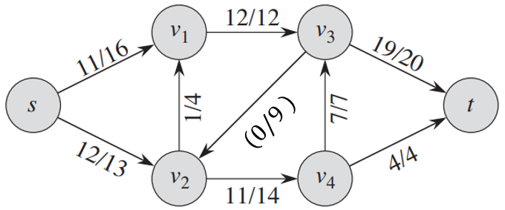



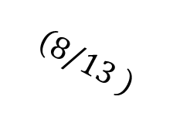







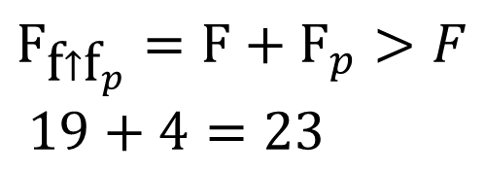






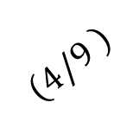






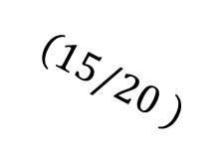
$$v_{1}$$
$$12$$
$$v_{3}$$
$$\left(15/20 \right)$$
$$5$$
$$5$$
$$\left(4/9 \right)$$
$${\text{c}}_{\text{f}}\left(P\right)=4$$
$$s$$
$$11$$
$$4$$
$$15$$
$$t$$
$$1$$
$$3$$
$$7$$
$$5$$
$$5$$
$$8$$
$$3$$
$$v_{4}$$
$$4$$
$$\left(8/13 \right)$$
$$v_{2}$$
$$11$$
$${\text{F}}_{\text{f}↑{\text{f}}_{p}}=\text{F}+{\text{F}}_{p}>F$$
$19+4=23$

Slide 15
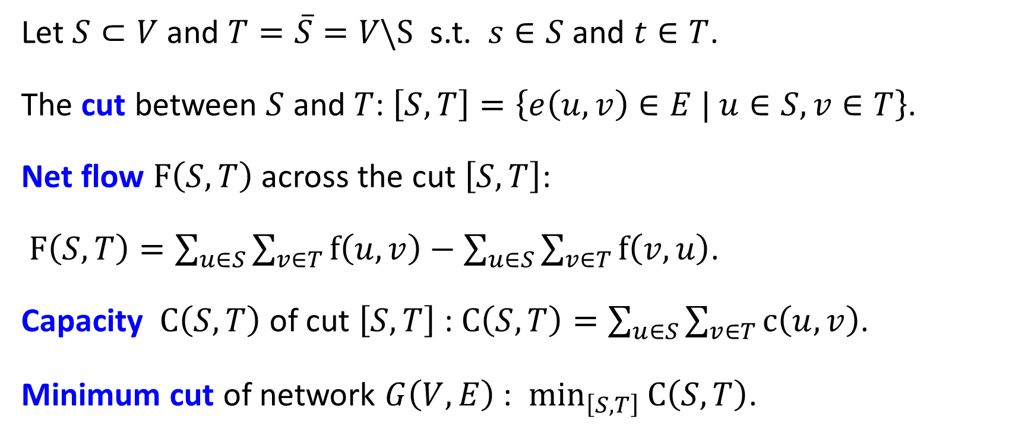
Cuts
Let $S⊂V$ and $T=\overline{S}=V\backslash S$ s.t. $s∈S$ and $t∈T$.
The cut between $S$ and $T$: $\left[S,T\right]=\left\{e\left(u,v\right)∈E | u∈S, v∈T\right\}$.
Net flow $\text{F}\left(S,T\right)$across the cut $\left[S,T\right]$:
$\text{F}\left(S,T\right)=\sum_{u∈S}{\sum_{v∈T}{\text{f}\left(u,v\right)}}−\sum_{u∈S}{\sum_{v∈T}{\text{f}\left(v,u\right)}}$.
Capacity $\text{C}\left(S,T\right)$ of cut $\left[S,T\right]$ : $\text{C}\left(S,T\right)=\sum_{u∈S}{\sum_{v∈T}{\text{c}\left(u,v\right)}}$.
Minimum cut of network $G\left(V,E\right)$ : $\min_{\left[S,T\right]}{\text{C}\left(S,T\right)}$.

Slide 16
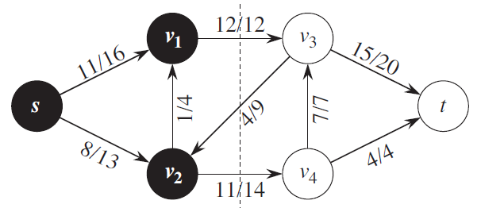
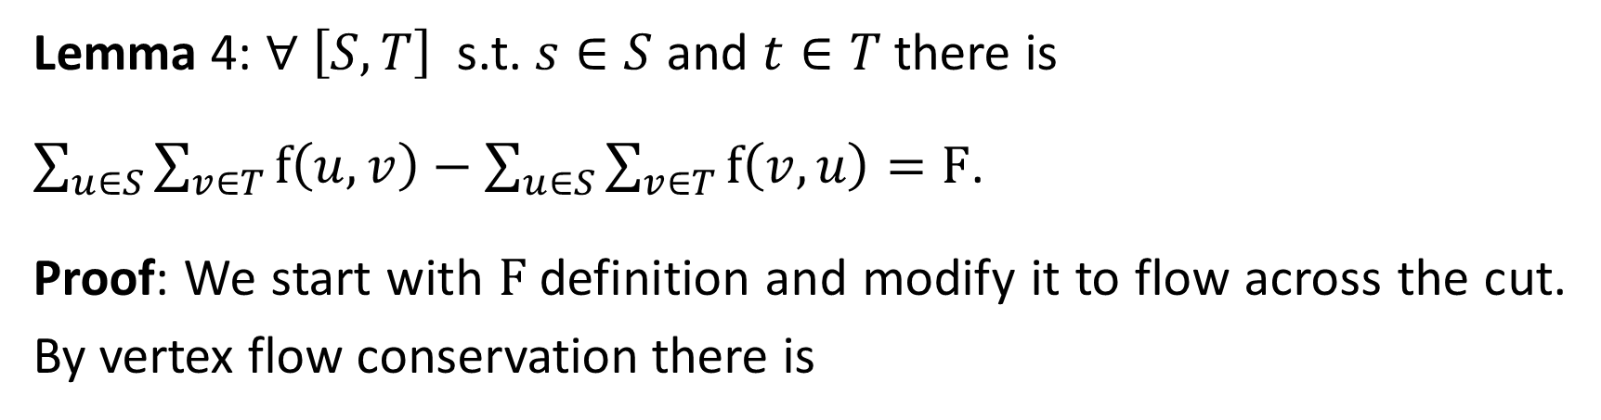
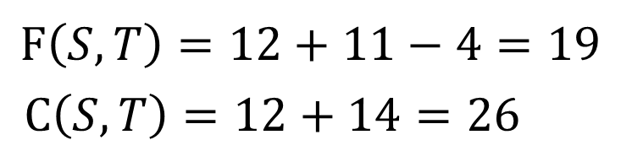


$$\text{F}\left(S,T\right)=12+11−4=19$$
$\text{C}\left(S,T\right)=12+14=26$
$$S$$
$$T$$
Lemma 4: ∀ $\left[S,T\right]$ s.t. $s∈S$ and $t∈T$ there is
$\sum_{u∈S}{\sum_{v∈T}{\text{f}\left(u,v\right)}}−\sum_{u∈S}{\sum_{v∈T}{\text{f}\left(v,u\right)}}=\text{F}$.
Proof: We start with $\text{F}$definition and modify it to flow across the cut. By vertex flow conservation there is

Slide 17
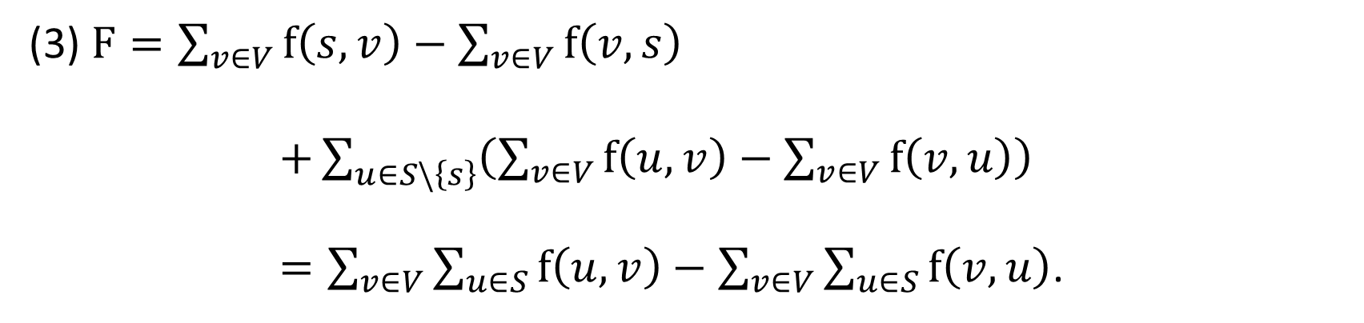
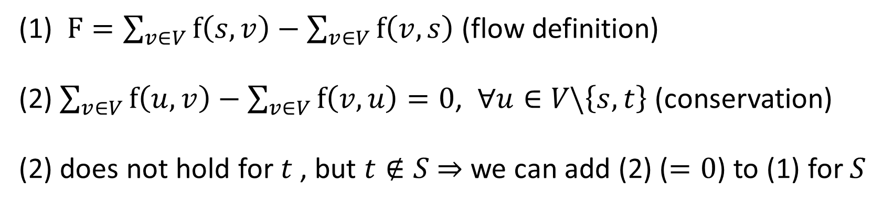

(1) $F=\sum_{v∈V}{\text{f}\left(s,v\right)}−\sum_{v∈V}{\text{f}\left(v,s\right)}$ (flow definition)
(2) $\sum_{v∈V}{\text{f}\left(u,v\right)}−\sum_{v∈V}{\text{f}\left(v,u\right)}=0$, $∀u∈V\backslash \left\{s,t\right\}$ (conservation)
(2) does not hold for $t$, but $t∉S$ ⇒ we can add (2) ($=0$) to (1) for $S$
(3) $F=\sum_{v∈V}{\text{f}\left(s,v\right)}−\sum_{v∈V}{\text{f}\left(v,s\right)}$
$+\sum_{u∈S\backslash \left\{s\right\}}{\left(\sum_{v∈V}{\text{f}\left(u,v\right)}−\sum_{v∈V}{\text{f}\left(v,u\right)}\right)}$
$=\sum_{v∈V}{\sum_{u∈S}{\text{f}\left(u,v\right)}}−\sum_{v∈V}{\sum_{u∈S}{\text{f}\left(v,u\right)}}$.
$$S\backslash s∪s=S$$

Slide 18
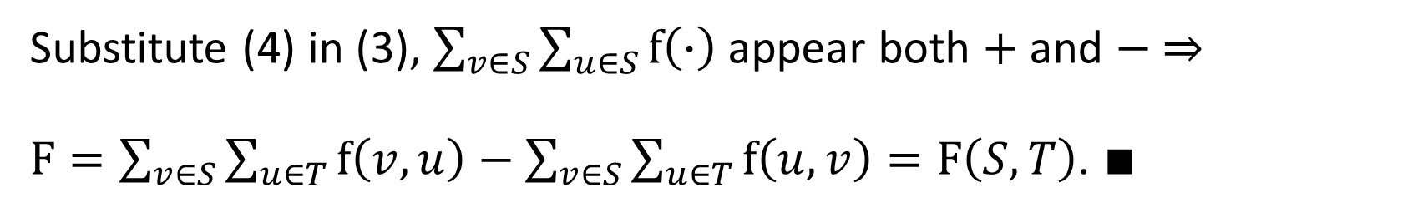

(4) $S=\overline{T}$ ⇒ $\sum_{v∈S}{\sum_{u∈V}{\text{f}\left(∙\right)}}=\sum_{v∈S}{\sum_{u∈S}{\text{f}\left(∙\right)}}+\sum_{v∈S}{\sum_{u∈T}{\text{f}\left(∙\right)}}$.
Substitute (4) in (3), $\sum_{v∈S}{\sum_{u∈S}{\text{f}\left(∙\right)}}$ appear both $+$ and $−$ ⇒
$F=\sum_{v∈S}{\sum_{u∈T}{\text{f}\left(v,u\right)}}−\sum_{v∈S}{\sum_{u∈T}{\text{f}\left(u,v\right)}}=F\left(S,T\right)$. $∎$
forward flow
backward flow
Corollary 5: Any flow $\text{F}$is upper bounded by any $C\left(S,T\right)$.
Proof: Let $\left[S,T\right]$ be any cut. Lemma 4 ⇒

Slide 19
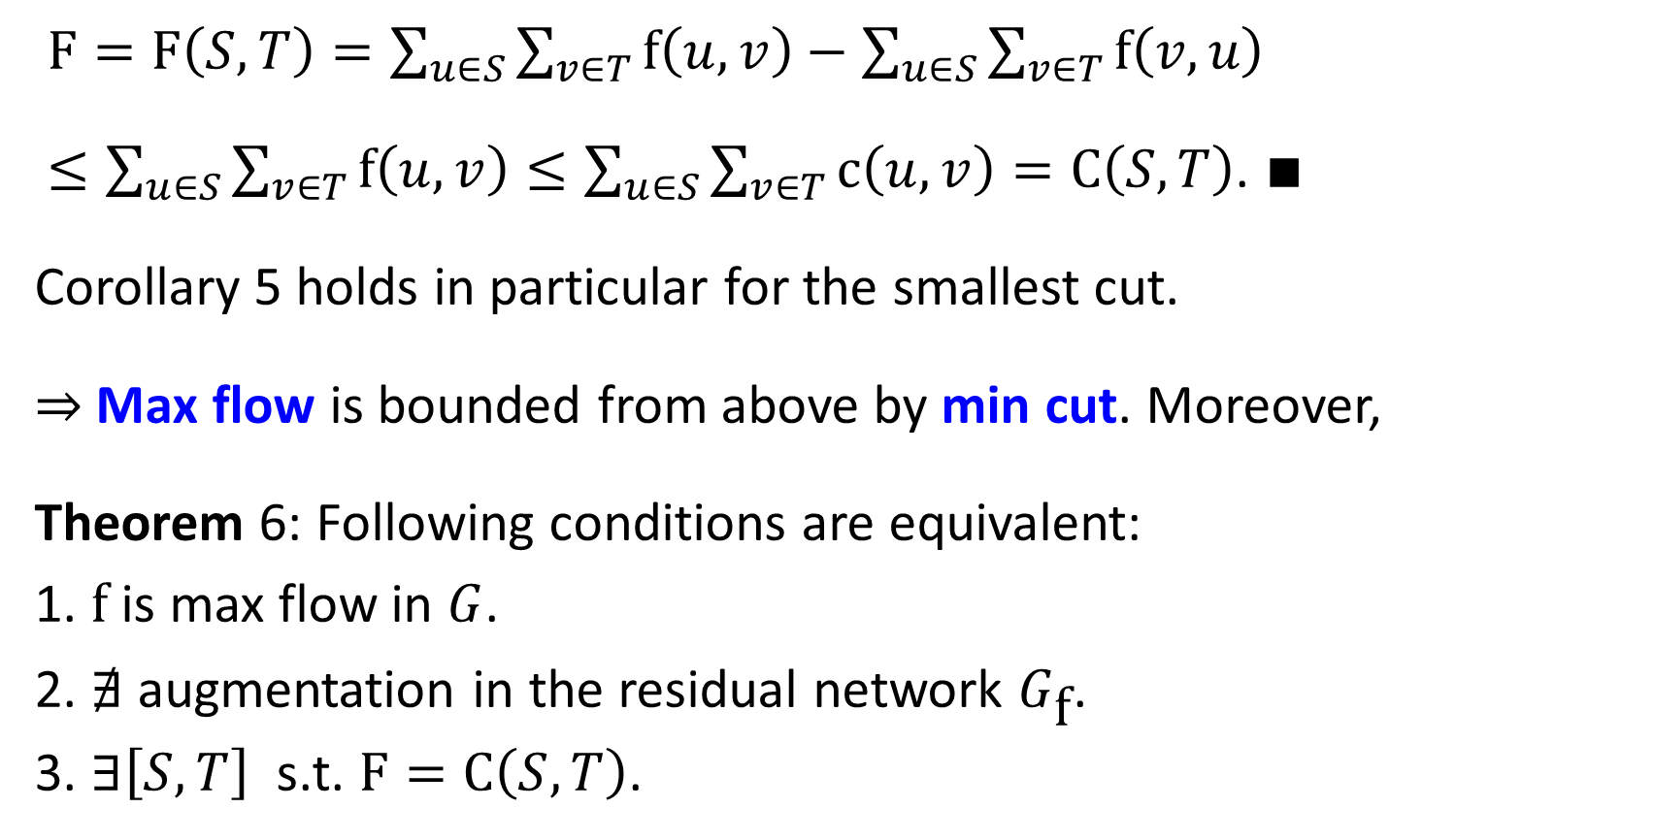
$F=\text{F}\left(S,T\right)=\sum_{u∈S}{\sum_{v∈T}{\text{f}\left(u,v\right)}}−\sum_{u∈S}{\sum_{v∈T}{\text{f}\left(v,u\right)}}$
$≤\sum_{u∈S}{\sum_{v∈T}{\text{f}\left(u,v\right)}}≤\sum_{u∈S}{\sum_{v∈T}{\text{c}\left(u,v\right)}}=\text{C}\left(S,T\right)$. $∎$
Corollary 5 holds in particular for the smallest cut.
⇒ Max flow is bounded from above by min cut. Moreover,
Theorem 6: Following conditions are equivalent:
1. $\text{f}$ is max flow in $G$.
2. $∄$ augmentation in the residual network $G_{\text{f}}$.
3. $∃\left[S,T\right]$ s.t. $F=\text{C}\left(S,T\right)$.

Slide 20
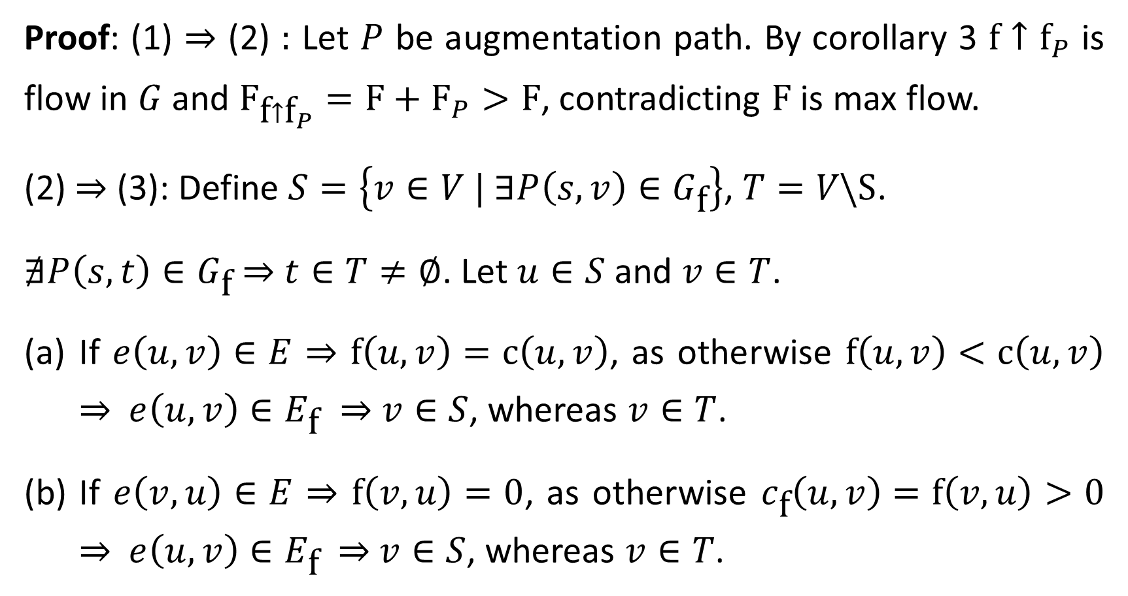
Proof: (1) ⇒ (2) : Let $P$ be augmentation path. By corollary 3 $\text{f}↑{\text{f}}_{P}$ is flow in $G$ and ${\text{F}}_{\text{f}↑{\text{f}}_{P}}=\text{F}+{\text{F}}_{P}>\text{F}$, contradicting $\text{F}$ is max flow.
(2) ⇒ (3): Define $S=\left\{v∈V | ∃P\left(s,v\right)∈G_{\text{f}}\right\}$, $T=V\backslash S$.
$∄P\left(s,t\right)∈G_{\text{f}}$ ⇒ $t∈T≠∅$. Let $u∈S$ and $v∈T$.
If $e\left(u,v\right)∈E$ ⇒ $\text{f}\left(u,v\right)=\text{c}\left(u,v\right)$, as otherwise $\text{f}\left(u,v\right)<\text{c}\left(u,v\right)$ ⇒ $e\left(u,v\right)∈E_{\text{f}}$ ⇒ $v∈S$, whereas $v∈T$.
If $e\left(v,u\right)∈E$ ⇒ $\text{f}\left(v,u\right)=0$, as otherwise $c_{\text{f}}\left(u,v\right)=\text{f}\left(v,u\right)>0$ ⇒ $e\left(u,v\right)∈E_{\text{f}}$ ⇒ $v∈S$, whereas $v∈T$.

Slide 21
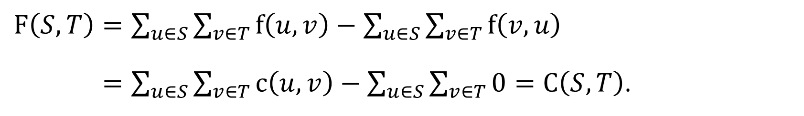
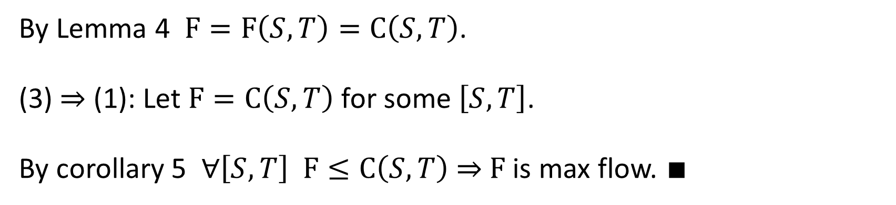
(c) If $e\left(u,v\right)∉E$ and $e\left(v,u\right)∉E$ ⇒ $\text{f}\left(u,v\right)=\text{f}\left(v,u\right)=0$. Hence,
$\text{F}\left(S,T\right)=\sum_{u∈S}{\sum_{v∈T}{\text{f}\left(u,v\right)}}−\sum_{u∈S}{\sum_{v∈T}{\text{f}\left(v,u\right)}}$
$=\sum_{u∈S}{\sum_{v∈T}{\text{c}\left(u,v\right)}}−\sum_{u∈S}{\sum_{v∈T}{0}}=\text{C}\left(S,T\right)$.
by (a)
by (b)
By Lemma 4 $\text{F}=\text{F}\left(S,T\right)=\text{C}\left(S,T\right)$.
(3) ⇒ (1): Let $F=\text{C}\left(S,T\right)$ for some $\left[S,T\right]$.
By corollary 5 $∀\left[S,T\right]$ $\text{F}≤\text{C}\left(S,T\right)$ ⇒ $\text{F}$ is max flow. $∎$

Slide 22
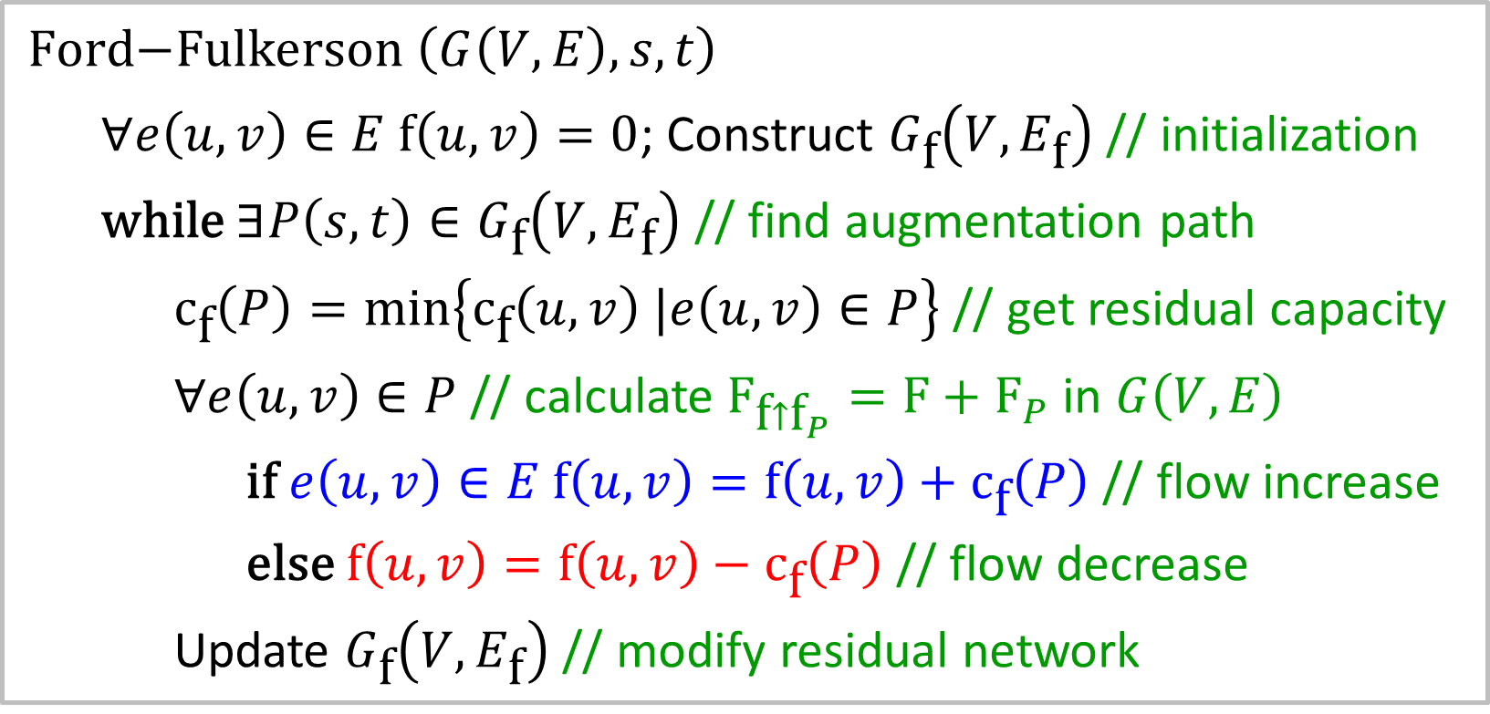
Ford-Fulkerson Algorithm
The min-cut max-flow Theorem 6 is translated into an algorithm.
$\text{Ford}\text{−}\text{Fulkerson} \left(G\left(V,E\right), s,t\right)$
$∀e\left(u,v\right)∈E \text{f}\left(u,v\right)=0$; Construct $G_{\text{f}}\left(V,E_{\text{f}}\right)$ // initialization
$\text{while}$ $∃P\left(s,t\right)∈G_{\text{f}}\left(V,E_{\text{f}}\right)$ // find augmentation path
${\text{c}}_{\text{f}}\left(P\right)=\min\left\{{\text{c}}_{\text{f}}\left(u,v\right) |e\left(u,v\right)∈P\right\}$ // get residual capacity
$∀e\left(u,v\right)∈P$ // calculate ${\text{F}}_{\text{f}↑{\text{f}}_{P}}=\text{F}+{\text{F}}_{P}$ in $G\left(V,E\right)$
$\text{if}$ $e\left(u,v\right)∈E$ $\text{f}\left(u,v\right)=\text{f}\left(u,v\right)+{\text{c}}_{\text{f}}\left(P\right)$ // flow increase
$\text{else}$ $\text{f}\left(u,v\right)=\text{f}\left(u,v\right)−{\text{c}}_{\text{f}}\left(P\right)$ // flow decrease
Update $G_{\text{f}}\left(V,E_{\text{f}}\right)$ // modify residual network
runtime critical

Slide 23




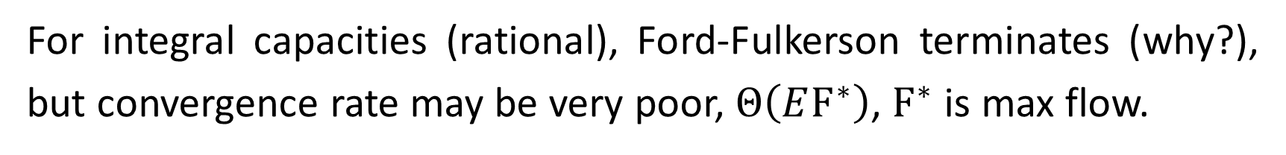

















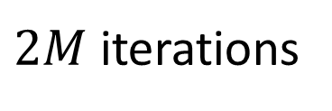






For integral capacities (rational), Ford-Fulkerson terminates (why?), but convergence rate may be very poor, $Θ\left(E{\text{F}}^{∗}\right)$, ${\text{F}}^{∗}$ is max flow.
$$M−1$$
$$M$$
$$s$$
$$1$$
$$1$$
$$t$$
$$1$$
$$M$$
$$M−1$$
$$M$$
$$M$$
$$M−1$$
$$M−1$$
$$t$$
$$1$$
$$1$$
$$t$$
$$s$$
$$1$$
$$s$$
$$1$$
$$1$$
$$1$$
$$M$$
$$M$$
$2M$ iterations
$$M−1$$
$$M−1$$

Slide 24
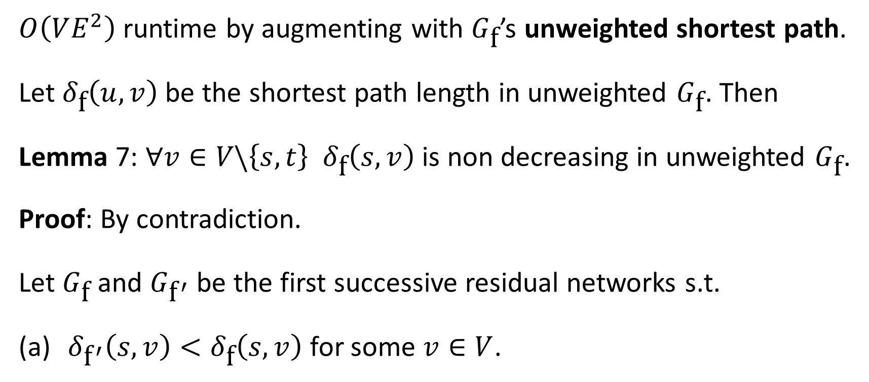
Edmonds-Karp Algorithm
$O\left(VE^{2}\right)$ runtime by augmenting with $G_{\text{f}}$’s unweighted shortest path.
Let $δ_{\text{f}}\left(u,v\right)$ be the shortest path length in unweighted $G_{\text{f}}$. Then
Lemma 7: ∀$v∈V\backslash \left\{s,t\right\}$ $δ_{\text{f}}\left(s,v\right)$ is non decreasing in unweighted $G_{\text{f}}$.
Proof: By contradiction.
Let $G_{\text{f}}$ and $G_{{\text{f}}^{′}}$ be the first successive residual networks s.t.
$δ_{{\text{f}}^{′}}\left(s,v\right)<δ_{\text{f}}\left(s,v\right)$ for some $v∈V$.

Slide 25
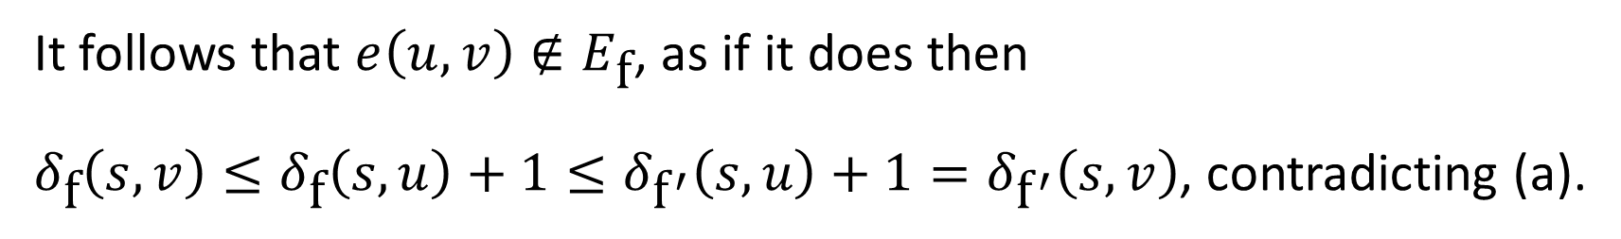
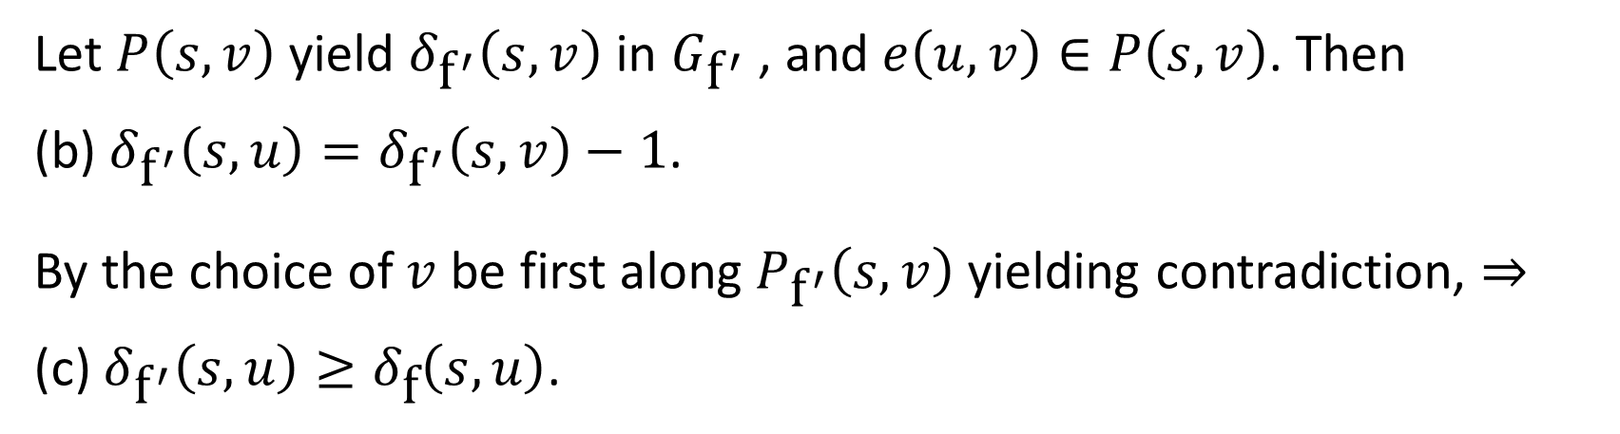
Let $P\left(s,v\right)$ yield $δ_{{\text{f}}^{′}}\left(s,v\right)$ in $G_{{\text{f}}^{′}}$ , and $e\left(u,v\right)∈P\left(s,v\right)$. Then
(b) $δ_{{\text{f}}^{′}}\left(s,u\right)=δ_{{\text{f}}^{′}}\left(s,v\right)−1$.
By the choice of $v$ be first along $P_{{\text{f}}^{′}}\left(s,v\right)$ yielding contradiction, ⇒
(c) $δ_{{\text{f}}^{′}}\left(s,u\right)≥δ_{\text{f}}\left(s,u\right)$.
It follows that $e\left(u,v\right)∉E_{\text{f}}$, as if it does then
$δ_{\text{f}}\left(s,v\right)≤δ_{\text{f}}\left(s,u\right)+1≤δ_{{\text{f}}^{′}}\left(s,u\right)+1=δ_{{\text{f}}^{′}}\left(s,v\right)$, contradicting (a).
by (c)
by (b)
by shortest path triangle inequality

Slide 26
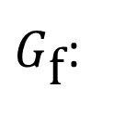
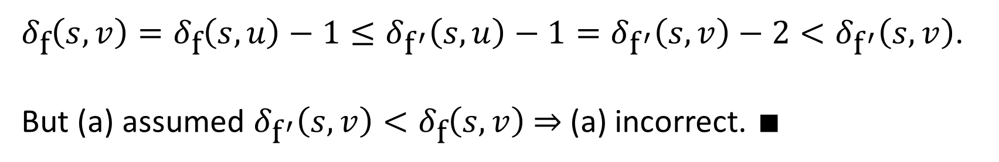

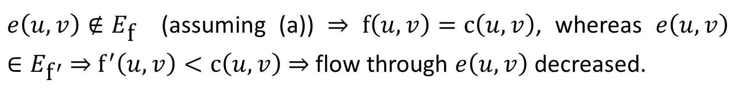


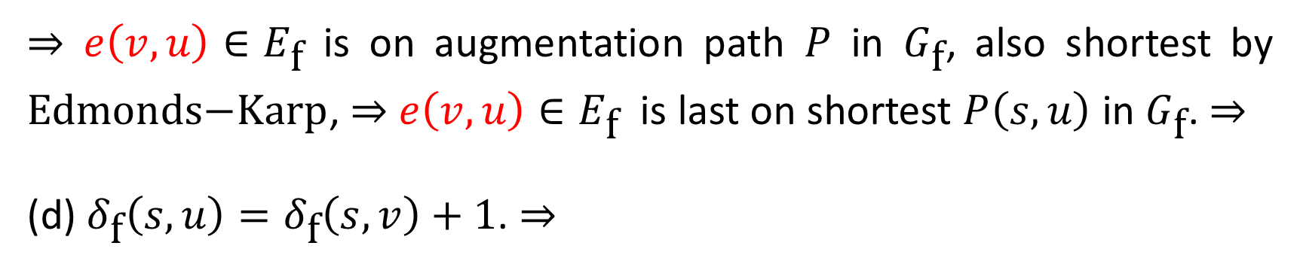
$e\left(u,v\right)∉E_{\text{f}}$ (assuming (a)) ⇒ $f\left(u,v\right)=\text{c}\left(u,v\right)$, whereas $e\left(u,v\right)∈E_{{\text{f}}^{′}}$ ⇒ ${\text{f}}^{′}\left(u,v\right)<\text{c}\left(u,v\right)$ ⇒ flow through $e\left(u,v\right)$ decreased.
⇒ $e\left(v,u\right)∈E_{\text{f}}$ is on augmentation path $P$ in $G_{\text{f}}$, also shortest by $\text{Edmonds}\text{−}\text{Karp}$, ⇒ $e\left(v,u\right)∈E_{\text{f}}$ is last on shortest $P\left(s,u\right)$ in $G_{\text{f}}$. ⇒
(d) $δ_{\text{f}}\left(s,u\right)=δ_{\text{f}}\left(s,v\right)+1$. ⇒
$G_{\text{f}}$:
$$s$$
$$v$$
$$u$$
$δ_{\text{f}}\left(s,v\right)=δ_{\text{f}}\left(s,u\right)−1≤δ_{{\text{f}}^{′}}\left(s,u\right)−1=δ_{{\text{f}}^{′}}\left(s,v\right)−2<δ_{{\text{f}}^{′}}\left(s,v\right)$.
But (a) assumed $δ_{{\text{f}}^{′}}\left(s,v\right)<δ_{\text{f}}\left(s,v\right)$ ⇒ (a) incorrect. $∎$
By (d)
by (c)
by (b)

Slide 27
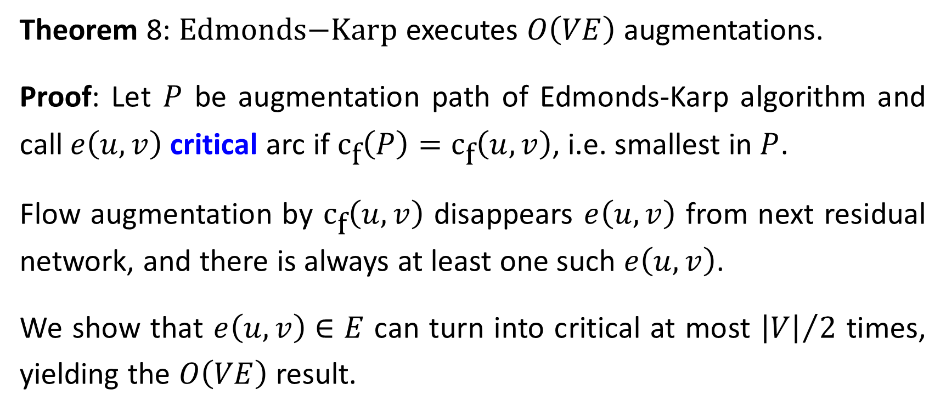
Theorem 8: $\text{Edmonds}\text{−}\text{Karp}$ executes $O\left(VE\right)$ augmentations.
Proof: Let $P$ be augmentation path of Edmonds-Karp algorithm and call $e\left(u,v\right)$ critical arc if ${\text{c}}_{\text{f}}\left(P\right)={\text{c}}_{\text{f}}\left(u,v\right)$, i.e. smallest in $P$.
Flow augmentation by ${\text{c}}_{\text{f}}\left(u,v\right)$ disappears $e\left(u,v\right)$ from next residual network, and there is always at least one such $e\left(u,v\right)$.
We show that $e\left(u,v\right)∈E$ can turn into critical at most ${\left|V\right|}/2$ times, yielding the $O\left(VE\right)$ result.

Slide 28

Let $e\left(u,v\right)$ be critical for the first time. $P$shortest in $G_{\text{f}}$ ⇒
(a) $δ_{\text{f}}\left(s,v\right)=δ_{\text{f}}\left(s,u\right)+1$.
Augmentation disappears $e\left(u,v\right)$ from next residual network, and rather $e\left(v,u\right)$ appears (with capacity $c_{\text{f}}\left(v,u\right)\text{=}\text{c}\left(u,v\right)$).
Let ${\text{f}}^{′}$ be first flow when $e\left(v,u\right)∈P$ augmentation path, also shortest by $\text{Edmonds}\text{−}\text{Karp}$ ⇒
(b) $δ_{{\text{f}}^{′}}\left(s,u\right)=δ_{{\text{f}}^{′}}\left(s,v\right)+1$.
$\text{f}$ earlier and ${\text{f}}^{′}$ later ⇒

Slide 29



$δ_{{\text{f}}^{′}}\left(s,u\right)=δ_{{\text{f}}^{′}}\left(s,v\right)+1≥δ_{\text{f}}\left(s,v\right)+1=δ_{\text{f}}\left(s,u\right)+2$.
by (b)
$\text{f}$ earlier than ${\text{f}}^{′}$ (Lemma 7)
by (a)
Consequently, upon two successive times when$e\left(u,v\right)$becomes critical $δ_{\left(∙\right)}\left(s,u\right)$ in the residual network increases by at least 2.
Since $δ_{\left(∙\right)}\left(s,u\right)$ cannot exceed $\left|V\right|$ $e\left(u,v\right)$ can be critical at most ${\left|V\right|}/2$ times ⇒ Edmonds-Karp executes $O\left(VE\right)$ augmentations. $∎$
Since an augmentation employs a shortest path which requires $O\left(E\right)$ time ⇒ Edmonds-Karp runs $O\left(VE^{2}\right)$ time.

Slide 30

Push-Relabel Algorithm (Goldberg and Tarjan 1986)
Flow algorithm runs in $O\left(V^{2}E\right)$, improving Edmonds-Karp $O\left(VE^{2}\right)$.
Rather than examining the entire residual network, it works on one vertex at a time, looking only at its outgoing neighbors.
Flow-conservation does not hold, and excess is allowed in a so called preflow
$u.\text{excess}=\sum_{v∈V}{\text{f}\left(v,u\right)}−\sum_{v∈V}{\text{f}\left(u,v\right)}≥0$, $∀u∈V\backslash \left\{s\right\}$.
$u∈V\backslash \left\{s,t\right\}$ is overflowing if $u.\text{excess}>0$.

Slide 31

Each vertex has a reservoir that accumulates excess flow.
Each vertex sits on a platform whose height increases as the algorithm is progressing.
Flow is pushed only downhill, from higher to lower vertex.
The height of the source $s$ is fixed at $\left|V\right|$ and the sink $t$ at $0$. All other vertex heights start at 0 and increase with time.
Algorithm first pushes as much flow as possible downhill from $s$ to $t$, saturating the capacity of $\left[s,V\backslash \left\{s\right\}\right]$, then further pushing it downhill.

Slide 32

It may eventually happen that the only unsaturated outgoing arcs from $u$ connect to vertices on the same level or higher than $u$.
To rid of its excess flow we apply relabeling, increasing $u$height to 1 above the height of the lowest of its relevant neighbors.
$u$ then has at least one outgoing arc for pushing more flow.
Eventually, all the flow that can get through to $t$ arrives there.

Slide 33

To legalize the preflow, we send the excess at vertices back to $s$by relabeling vertices above $s$’s fixed height $\left|V\right|$.
Once there are no excess flows at vertices, the flow is legal and maximum (proved later).
A function $h:V→ℕ$ is a height function if $h\left(s\right)=\left|V\right|$, $h\left(t\right)=0$, and $h\left(u\right)≤h\left(v\right)+1$, $∀e\left(u,v\right)∈E_{\text{f}}$ (residual network).
(Proved later that such function exists). By $h$’s very definition there is
Lemma 9: Let $\text{f}$ be a preflow. If $h\left(u\right)>h\left(v\right)+1$ then $e\left(u,v\right)∉E_{\text{f}}$ .

Slide 34


Push and Relabel Operation
Push applies when $u$ overflows, $c_{\text{f}}\left(u,v\right)>0$, and $h\left(u\right)=h\left(v\right)+1$.
It pushes $∆_{f}\left(u,v\right)$, the max legitimate amount of flow from $u$ to $v$.
$\text{PUSH}\left(u,v\right)$ // pushes flow from $u$ to $v$ and updates all attributes
$∆_{f}\left(u,v\right)=\min\left(u.\text{excess} ,c_{f}\left(u,v\right)\right)$ // flow amount to push
$\text{if} e\left(u,v\right)∈E$ // check arc direction between $u$ and $v$ in $G\left(V,E\right)$
$f\left(u,v\right)+=∆_{f}\left(u,v\right)$ // increase flow from $u$ to $v$
$\text{else} f\left(v,u\right)−=∆_{f}\left(u,v\right)$ // decrease flow from $v$ to $u$
$u.\text{excess}−=∆_{f}\left(u,v\right)$ // decrease excess flow at vertex $u$
$v.\text{excess}+=∆_{f}\left(u,v\right)$ // increase excess flow at vertex $v$

Slide 35

We push excess flow downhill only by height differential of 1.
By Lemma 9 no residual arcs exist between vertices whose heights differ by more than 1.
Thus, push-relabel must preserve this invariant (proven later).
$\text{PUSH}\left(u,v\right)$ is saturating if $e\left(u,v\right)∈E_{\text{f}}$ becomes saturated, i.e., $c_{f}\left(u,v\right)=0$. Otherwise it is nonsaturating.
Lemma 10: After nonsaturating push from $u$ to $v$, $u$ is no longer overflowing ($u.\text{excess}\text{=0}$(. (HW)

Slide 36

Relabel applies when excess flow cannot be pushed downhill
$u$ is overflowing ($u.\text{excess}>0$) , and
$h\left(u\right)≤h\left(v\right)$ $∀e\left(u,v\right)∈E_{\text{f}}$ ($∃e\left(u,v\right)∈E_{\text{f}}⇒$ $c_{f}\left(u,v\right)>0$)
Then $h\left(u\right)=\text{1+}\text{min}\left\{h\left(v\right) | e\left(u,v\right)∈E_{\text{f}}\right\}$
$s$ and $t$ never relabeled as by definition they cannot overflow.
Relabeling is well-defined, i.e., min is taken on non empty set.
$u.\text{excess}\text{= }\sum_{v∈V}{\text{f}\left(v,u\right)}−\sum_{v∈V}{\text{f}\left(u,v\right)}>0$ and $\text{f}≥0$ ⇒
$\sum_{v∈V}{\text{f}\left(v,u\right)}>0$ , ⇒ $∃e\left(v,u\right)$ s.t. $\text{f}\left(v,u\right)>0$, ⇒ $∃e\left(u,v\right)∈E_{\text{f}}$ .

Slide 37

The Algorithm
$\text{INIT}\text{−}\text{PREFLOW}\left(G\left(V,E\right),s\right)$ // initialization
$∀v∈V$
$h\left(v\right)=0 ; v.\text{excess}\text{ =0}$ // reset height and excess flow
$∀e\left(u,v\right)∈E$ $\left\{\text{f}\left(u,v\right)=0\right\}$ // reset arc flows
$h\left(s\right)=\left|V\right|$ // set source height to highest
$∀e\left(s,v\right)∈E$ // initialize source
$\text{f}\left(s,v\right)=c\left(s,v\right)$ // saturate outgoing arc
$v.\text{excess} \text{=} c\left(s,v\right)$ // overflow adjacent vertex
$s.\text{excess}−\text{=}c\left(s,v\right)$ // source excess is negative

Slide 38


By initialization only $s$’s outgoing arcs $e\left(s,v\right)$ satisfy $h\left(s\right)>h\left(v\right)+1$.
$s$’s outgoing arcs are anyway initially saturated, hence do exist in the residual network $G_{\text{f}}\left(V,E_{\text{f}}\right)$ and $h\left(s\right)>h\left(v\right)+1$ adheres definition.
$\text{PUSH}\text{−}\text{RELABEL}$executes push or relabel in no particular order
$\text{PUSH}\text{−}\text{RELABEL}\left(G\left(V,E\right)\right)$
$\text{INIT}\text{−}\text{PRE}\text{FLOW}\left(G\left(V,E\right),s\right)$
$\text{while}$there exists an applicable push or relabel operation
select push or relabel and perform it

Slide 39


































$$0/13$$
$$0/6$$
$$0/10$$
$$0/5$$
$$s$$
$$a$$
$$c$$
$$d$$
$$t$$
$$0/10$$
$$0/3$$
$$b$$
$$0/7$$
$$6/−$$
$$0/13$$
$$0/0$$
$$0/0$$
$$0/−$$
$$13/13$$
$$0/6$$
$$0/10$$
$$0/5$$
$$s$$
$$a$$
$$c$$
$$d$$
$$t$$
$$10/10$$
$$0/3$$
$$b$$
$$0/10$$
$\text{+}\text{f}\text{/}\text{c}$ or $−\text{f}\text{/}\text{c}$
$$0/7$$
$$\text{h}\left(u\right)\text{/}u\text{.}\text{excess}$$

Slide 40






































$$6/−$$
$$0/16$$
$$0/0$$
$$0/0$$
$$0/−$$
$$13/13$$
$$0/6$$
$$0/10$$
$$0/5$$
$$s$$
$$a$$
$$c$$
$$d$$
$$t$$
$$10/10$$
$$3/3$$
$$b$$
$$1/7$$
$$0/7$$
$$6/−$$
$$1/3$$
$$0/6$$
$$0/0$$
$$0/−$$
$$13/13$$
$$6/6$$
$$0/10$$
$$0/5$$
$$s$$
$$a$$
$$c$$
$$d$$
$$t$$
$$10/10$$
$$3/3$$
$$b$$
$$1/7$$
$$7/7$$

Slide 41



























$$6/−$$
$$1/3$$
$$1/0$$
$$0/6$$
$$0/−$$
$$13/13$$
$$6/6$$
$$6/10$$
$$0/5$$
$$s$$
$$a$$
$$c$$
$$d$$
$$t$$
$$10/10$$
$$3/3$$
$$b$$
$$1/7$$
$$7/7$$
$$6/−$$
$$1/3$$
$$1/0$$
$$1/1$$
$$0/−$$
$$13/13$$
$$6/6$$
$$6/10$$
$$5/5$$
$$s$$
$$a$$
$$c$$
$$d$$
$$t$$
$$10/10$$
$$3/3$$
$$b$$
$$1/7$$
$$7/7$$

Slide 42






































$$6/−$$
$$1/3$$
$$1/1$$
$$2/0$$
$$0/−$$
$$13/13$$
$$6/6$$
$$5/10$$
$$5/5$$
$$s$$
$$a$$
$$c$$
$$d$$
$$t$$
$$10/10$$
$$3/3$$
$$b$$
$$1/7$$
$$7/7$$
$$6/−$$
$$1/4$$
$$2/0$$
$$2/0$$
$$0/−$$
$$13/13$$
$$5/6$$
$$5/10$$
$$5/5$$
$$s$$
$$a$$
$$c$$
$$d$$
$$t$$
$$10/10$$
$$3/3$$
$$b$$
$$1/7$$
$$7/7$$

Slide 43






































$$6/−$$
$$2/1$$
$$2/0$$
$$2/0$$
$$0/−$$
$$13/13$$
$$5/6$$
$$5/10$$
$$5/5$$
$$s$$
$$a$$
$$c$$
$$d$$
$$t$$
$$10/10$$
$$0/3$$
$$b$$
$$1/10$$
$$7/7$$
$$6/−$$
$$7/0$$
$$2/0$$
$$2/0$$
$$0/−$$
$$12/13$$
$$5/6$$
$$5/10$$
$$5/5$$
$$s$$
$$a$$
$$c$$
$$d$$
$$t$$
$$10/10$$
$$0/3$$
$$b$$
$$1/10$$
$$7/7$$

Slide 44
































$$6/−$$
$$7/0$$
$$2/0$$
$$2/0$$
$$0/−$$
$$12/13$$
$$5/6$$
$$5/10$$
$$5/5$$
$$s$$
$$a$$
$$c$$
$$d$$
$$t$$
$$0/10$$
$$0/3$$
$$b$$
$$7/10$$
$$7/7$$
$$12/13$$
$$5/6$$
$$5/10$$
$$5/5$$
$$s$$
$$a$$
$$c$$
$$d$$
$$t$$
$$0/10$$
$$0/3$$
$$b$$
$$7/7$$

Slide 45

Following lemma shows that $\text{PUSH}\text{−}\text{RELABEL}$ iterates as long as there is an overflowing vertex.
Lemma 11: Let $e\left(u,v\right)∈E_{\text{f}}$. If $u.\text{excess}\text{ > 0}$, then either push or relabel applies.
Proof: For any $e\left(u,v\right)∈E_{\text{f}}$ we have $h\left(u\right)≤h\left(v\right)+1$because $h$ is height function.
If $h\left(u\right)=h\left(v\right)+1$push operation applies.
If $h\left(u\right)<h\left(v\right)+1$then $h\left(u\right)≤h\left(v\right)$ and relabeling applies. ∎

Slide 46

Correctness
Lemma 12: $\text{PUSH}\text{−}\text{RELABEL}$ never decreases $h\left(u\right)$. Moreover, relabel increases $h\left(u\right)$ by at least 1. (HW)
Lemma 13: $\text{PUSH}\text{−}\text{RELABEL}$ maintains $h$ as height function.
Proof: By induction on operations. Initializations defines $h$ properly since $h\left(u\right)=0$ $∀u≠s$ and $h\left(s\right)=\left|V\right|$.
$∀e\left(u,v\right)∈E_{\text{f}}$ outgoing arc, $\text{RELABEL}$ operation ensures $h\left(u\right)≤h\left(v\right)+1$ afterward.

Slide 47

$∀e\left(w,u\right)∈E_{\text{f}}$ ingoing arc, by induction there is $h\left(w\right)≤h\left(u\right)+1$ before $\text{RELABEL}$ and $h\left(w\right)<h\left(u\right)+1$ afterward.
Thus $\text{RELABEL}$ preserves $h$ as height function.
$\text{PUSH}$ operation may add $e\left(v,u\right)∈E_{\text{f}}$, case where $h\left(u\right)=h\left(v\right)+1$ before. $\text{PUSH}$ unchanging height, so $h\left(v\right)=h\left(u\right)−1<h\left(u\right)+1$.
$\text{PUSH}$ operation may also remove $e\left(u,v\right)∈E_{\text{f}}$. Then the height constraint is dropped anyway. $∎$
Lemma 14: Valid height function avoids any augmentation path in $G_{\text{f}}$.

Slide 48

Proof: By contradiction. Let $P\left(s,t\right)∈G_{\text{f}}$ be an augmentation path $\left(v_{0},v_{1},…,v_{k}\right)$, $v_{0}=s$, $v_{k}=t$. W.l.o.g $P\left(s,t\right)$ is simple.
There is $h\left(v_{i}\right)≤h\left(v_{i+1}\right)+1$, $0≤i≤k−1$. ⇒
$\left|V\right|=h\left(s\right)≤h\left(t\right)+k=0+k=k≤\left|V\right|−1$, contradiction. ∎
Theorem 15: (push-relabel correctness):
If PUSH-RELABEL terminates, the preflow is a maximum flow for $G$.
Proof: Throughout execution the algorithm ensures that $\text{f}$ is indeed a preflow.

Slide 49

Initialization: It first creates preflow in $\text{INIT}\text{−}\text{PREFLOW}$.
Maintenance: Relabel affect only height and not flow values, whereas a preflow prior to push operation remains such afterward.
Termination: At termination $u.excess=0$ $∀u∈V\backslash \left\{s,t\right\}$ ⇒ $\text{f}$ legal.
Lemma 13 ensures $h$ is height function.
As such, Lemma 14 ensures $∄$P$\left(s,t\right)$ augmentation path in $G_{\text{f}}$. ∎

Slide 50

Run Time
Lemma 16: $u.\text{excess}>0$ ⇒ $∃P\left(u,s\right)∈G_{\text{f}}$. (HW, CLRS 26.4)
Lemma 17: At any time of $\text{PUSH}\text{−}\text{RELABEL}$, $∀u∈V$there is, $h\left(u\right)≤2\left|V\right|−1$. (HW, CLRS 26.4)
To show that termination occurs, we bound the number of relabels, saturating pushes, and nonsaturating pushes in $\text{PUSH}\text{−}\text{RELABEL}$.
For relabel operation, $∀u∈V\backslash \left\{s,t\right\}$, $h\left(u\right)$ never decreases. By lemma 17 the per node relabels $≤2\left|V\right|−1$
$⇒$ (a) less than $\left(\left|V\right|−2\right)\left(2\left|V\right|−1\right)<$ $2{\left|V\right|}^{2}$ relabel operations.

Slide 51

Saturating push operation removes $e\left(u,v\right)∈G_{\text{f}}$. For $e\left(u,v\right)$ to be reinserted into $G_{\text{f}}$, $v$needs to push back to $u$ along $e\left(v,u\right)∈G_{\text{f}}$ .
This cannot happen unless $h\left(v\right)$ was increased by $2$, $⇒$ increase by $2$ of $h\left(u\right)$. Since height $≤2|V|−1$ $⇒$ An increase by 2 occurs less than $|V|$ times.
Since two successive saturating push along$e\left(u,v\right)∈G_{\text{f}}$ requires the relabeling of both vertices, considering all edges
$⇒$ (b) less than $2|E||V|$ saturating pushes.

Slide 52



For nonsaturating push define potential $Φ=\sum_{\left\{v∈V|v.\text{e}\text{xcess}>0\right\}}{h\left(v\right)}$.
$u∈V$ can contribute to $Φ$ increase, and $Φ$ may change due to $h$ (relabeling) and excess (push).
First, if $u$is relabeled, $h\left(u\right)≤2\left|V\right|−1$ by lemma 17. ⇒
(c) Relabeling of $u$ increases $Φ$by less than $2\left|V\right|$.
Second, saturating push along $e\left(u,v\right)∈G_{\text{f}}$ may cause $v\text{.}\text{excess}>0$, whose height $≤2\left|V\right|−1$ does not change. ⇒
(d) Saturating push increases $Φ$by less than $2\left|V\right|$.

Slide 53


⇒ $Φ$ increase due to relabeling and saturated pushes, summed to
$\left(2\left|V\right|\right)\left(2{\left|V\right|}^{2}\right)+\left(2\left|V\right|\right)\left(2\left|V\right|\left|E\right|\right)=4{\left|V\right|}^{2}\left(2\left|V\right|+\left|E\right|\right)$.
(c)
(a)
(d)
(b)
We show that nonsaturating push along $e\left(u,v\right)∈G_{\text{f}}$ decreases $Φ$ by at least $1$.
Before push $u$.$\text{excess}\text{>0}$, whereas either $v$.$\text{excess}\text{=}\text{0}$ or $v$.$\text{excess}\text{>}\text{0}$.
Since $\text{PUSH}$ performs $∆_{f}\left(u,v\right)=\min\left(u.\text{excess} ,c_{f}\left(u,v\right)\right),$non saturation means $u.\text{excess} ≤c_{f}\left(u,v\right)$, ⇒ $u.\text{excess}=0$ afterword.

Slide 54


$Φ$ has therefore decreased by $h\left(u\right)$ and either increased by $h\left(v\right)$ or not. ⇒ $∆Φ≤h\left(v\right)−h\left(u\right)≤h\left(v\right)−\left(h\left(v\right)+1\right)=−1$.
Since by definition $Φ≥0$, total increase bounds total decrease
(e) total nonsaturating pushes is less than $4{\left|V\right|}^{2}\left(2\left|V\right|+\left|E\right|\right)$.
Theorem 18: $\text{PUSH}\text{−}\text{RELABEL}$ terminates and its run-time is $O\left(V^{2}E\right)$.
Proof: Follows from (a), (b) and (e).

